Slide 1

Movie Rating Project Presentation
Welcome to our deep dive into movie ratings, where we transform raw data into actionable insights. This presentation will guide you through our analysis of movie performance, offering a data-driven perspective on what resonates with audiences.
Alok Kumar Choudhary

Slide 2
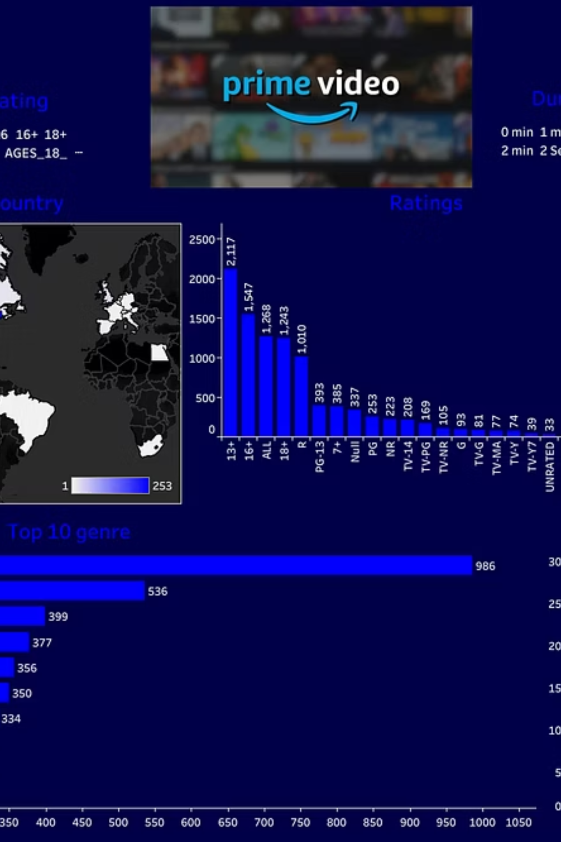

Explore the Interactive Tableau Dashboard
Dive deeper into the data with our interactive Tableau Dashboard, offering real-time exploration of movie ratings. Use filters to customize your view by genre, year, and rating scale.

Slide 3

Top 10 Movie Ratings Sample
This table provides a snapshot of our dataset, showcasing the top 10 movies sorted by their audience ratings on a 1-5 scale.
Movie Name
Rating
Shadows Within 2
1.5
Lunar Legacy 8
1.6
Forgotten Realms 9
4.5
Phantom Truth 2
1.4
Eternal Echoes 7
4.8
Ocean's Whisper 2
4.0
Silent Storm 2
2.6
Midnight Mirage 4
4.5
Midnight Mirage 4
1.5
Silent Storm 7
2.9

Slide 4
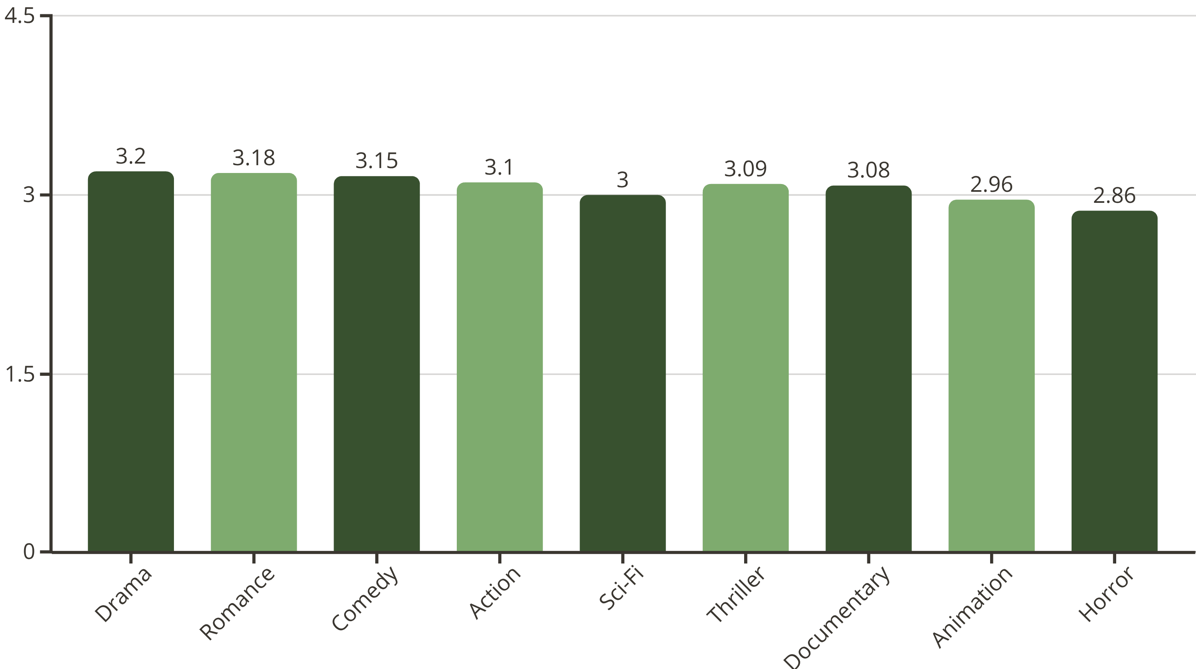
Average Rating by Genre
Discover which genres resonate most with audiences. This bar chart illustrates the average rating for various movie genres, highlighting audience preferences.

Slide 5

Movie Count by Genre
This pie chart illustrates the distribution of movies across different genres in our dataset, showcasing the most prevalent categories.
Documentary
Mystery
Horror
Thriller
Animation
Romance
Drama
Sci-Fi
Comedy
Fantasy
Action

Slide 6
Top 5 Highest-Rated Movies
Here are the cream of the crop, the top 5 highest-rated movies from our dataset, along with their respective genres. Ratings are sourced from a comprehensive audience survey.
1. Urban Legends 8
2. Phantom Truth 2
3. Silent Storm 1
Rating: 5.0 | Genre: Comedy
Rating: 5.0 | Genre: Animation
Rating: 5.0 | Genre: Action
4. Broken Circuit 7
5. Wanderlust 3
Rating: 5.0 | Genre: Action
Rating: 8.9 | Genre: Comedy

Slide 7

Thank You!
Thank you for your time and attention. We hope this presentation offered valuable insights into movie ratings.

